Slide 1

Investment Analytics System
Using Machine Learning
First Progress Report (6.7)
Group members:
Du Jianzhang, Wu Zhouyin, Yang Anjinyu, Xie Tianyou
Notes:
(DOSB) acceptance of chess
(a) a sport has to
include some form of physical activity; (b) it should convey ethical values, such as fair play, equal opportunities, as well as a
person’s inviolability; and (c) clear organisational structures need to be existent

Slide 2
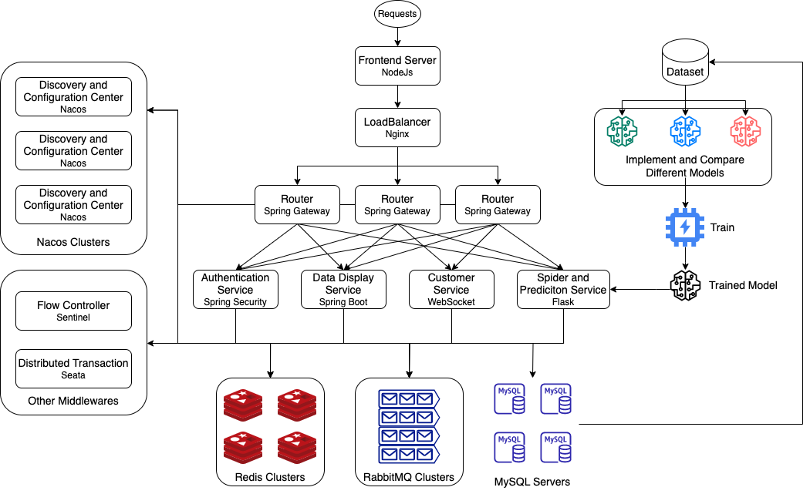
Overview
Notes:
(DOSB) acceptance of chess
(a) a sport has to
include some form of physical activity; (b) it should convey ethical values, such as fair play, equal opportunities, as well as a
person’s inviolability; and (c) clear organisational structures need to be existent

Slide 3
Technologies
Frontend
Backend
Algorithm
Java
Python
Spring Cloud
Flask
MySQL
Redis
RabbitMQ
HTML5
CSS
JavaScript
Vue 3
ElementUI
Python
PyTorch
Sklearn
RNN
Random Forest
...
Notes:
(DOSB) acceptance of chess
(a) a sport has to
include some form of physical activity; (b) it should convey ethical values, such as fair play, equal opportunities, as well as a
person’s inviolability; and (c) clear organisational structures need to be existent

Slide 4


Frontend
Flexible and Versatile
Reactive Data Binding
Component-Based Architecture
Consistency Feedback
Efficiency Controllability

Slide 5
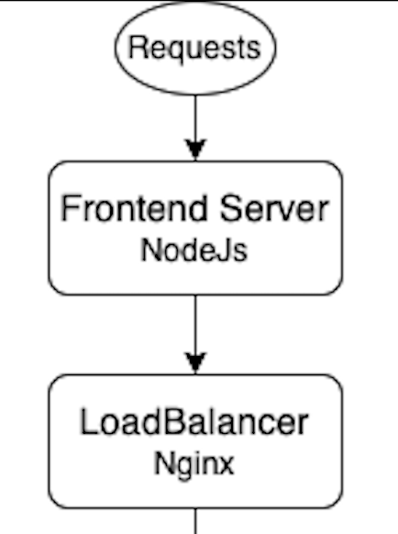
Frontend
Separation of frontend and backend
- HTTP request through Axios
- Solve cross-domain question
- Decoupling
- Development concurrently

Slide 6
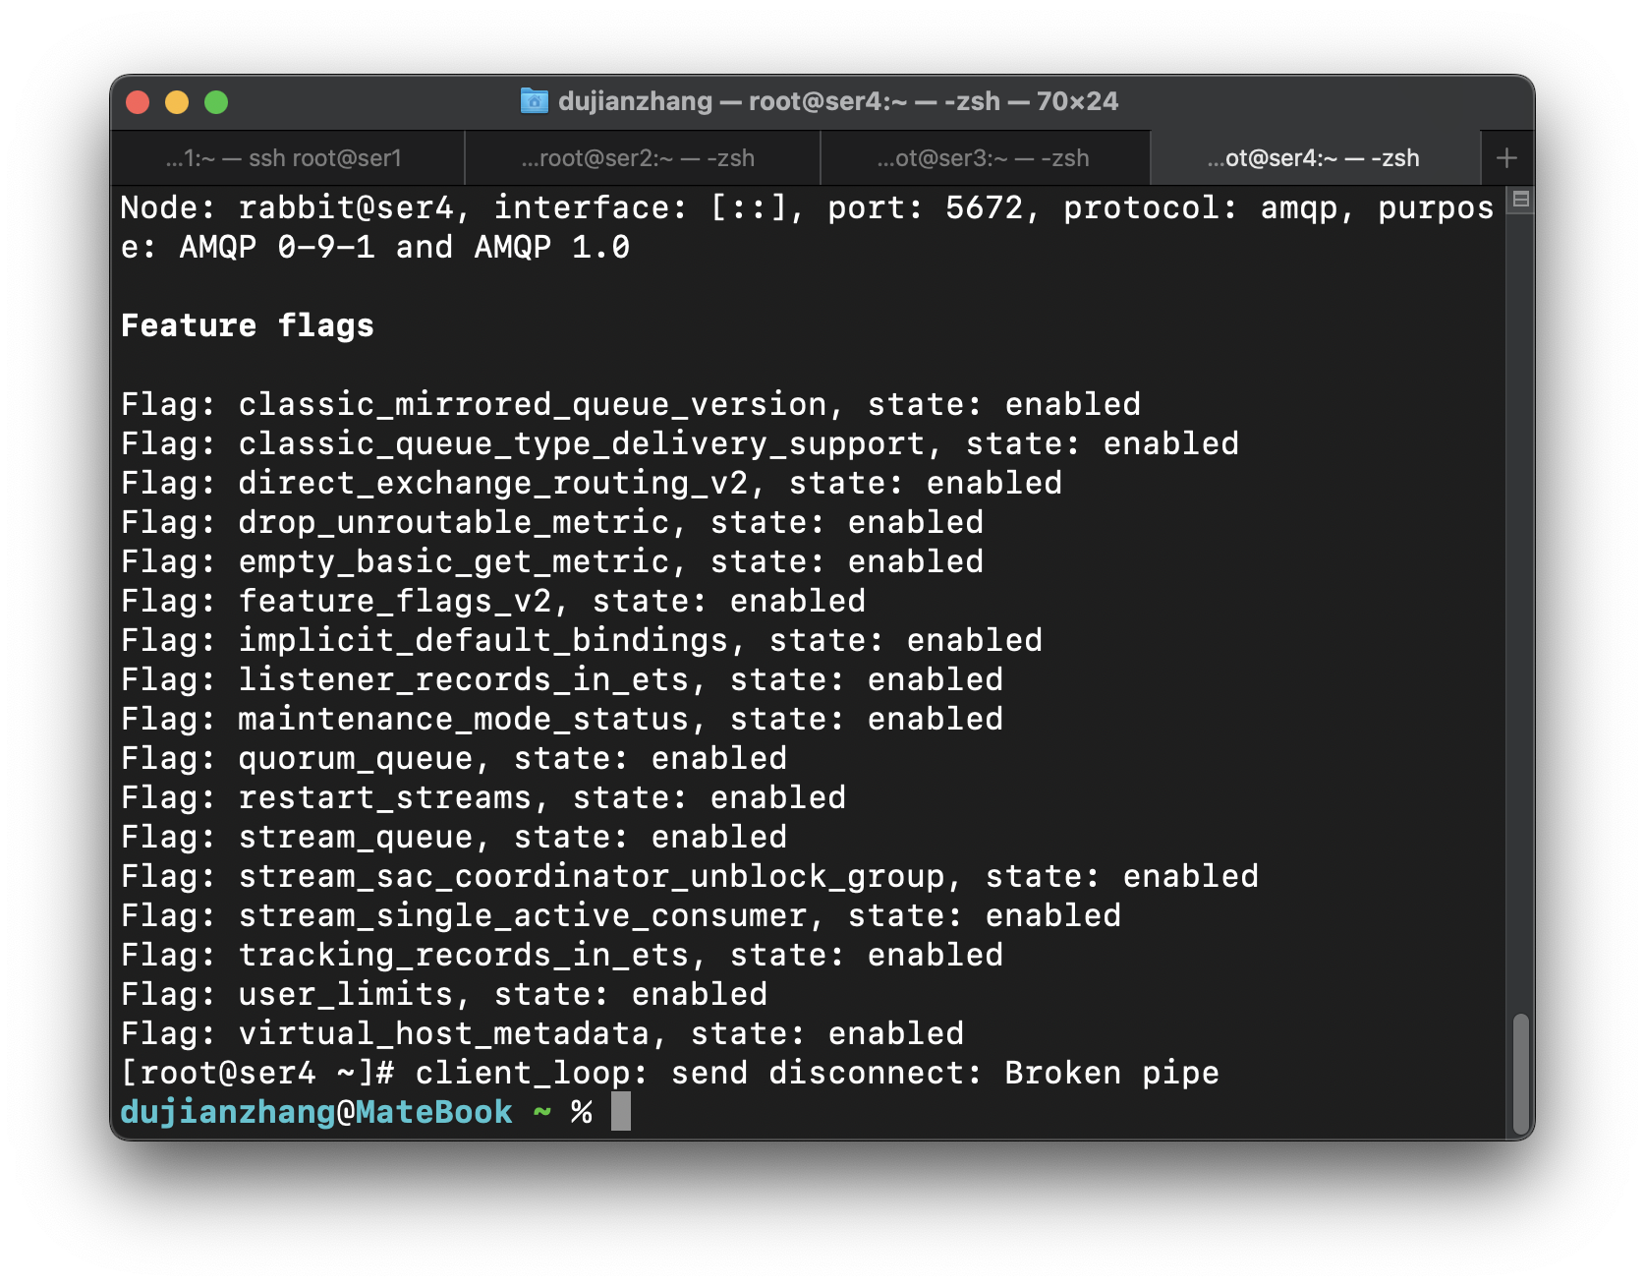
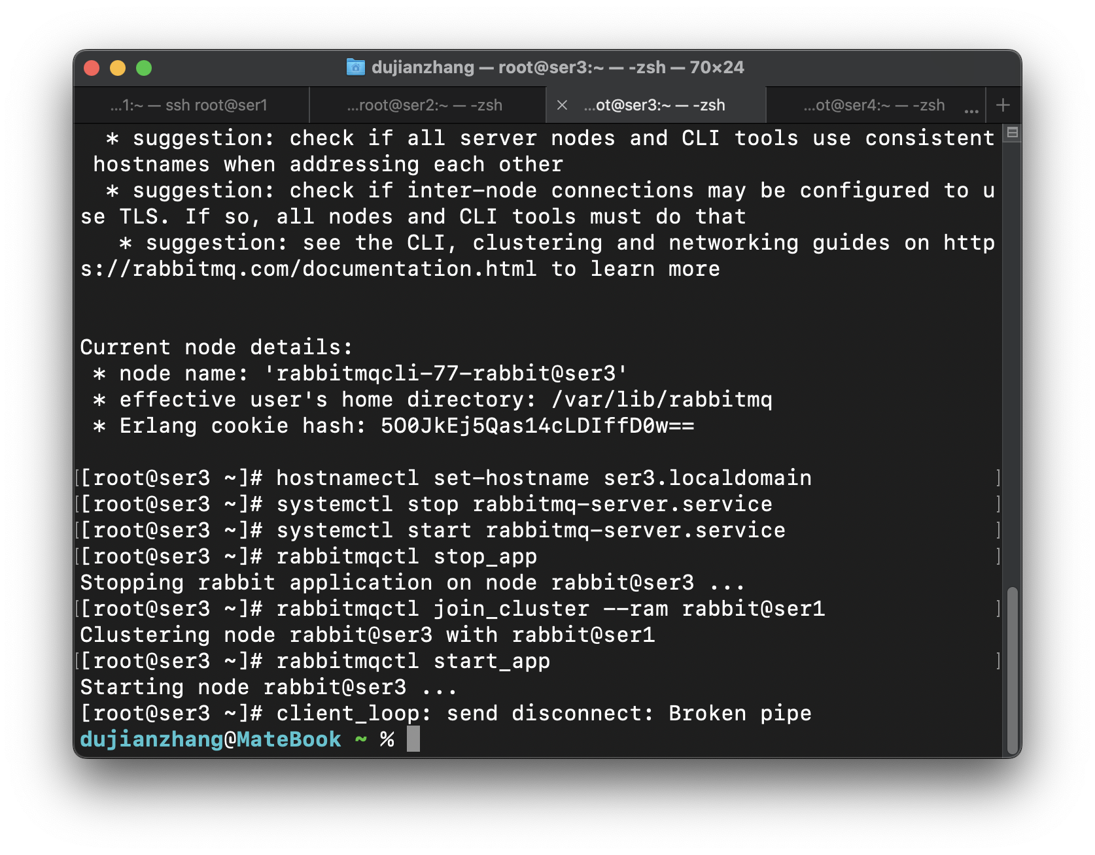
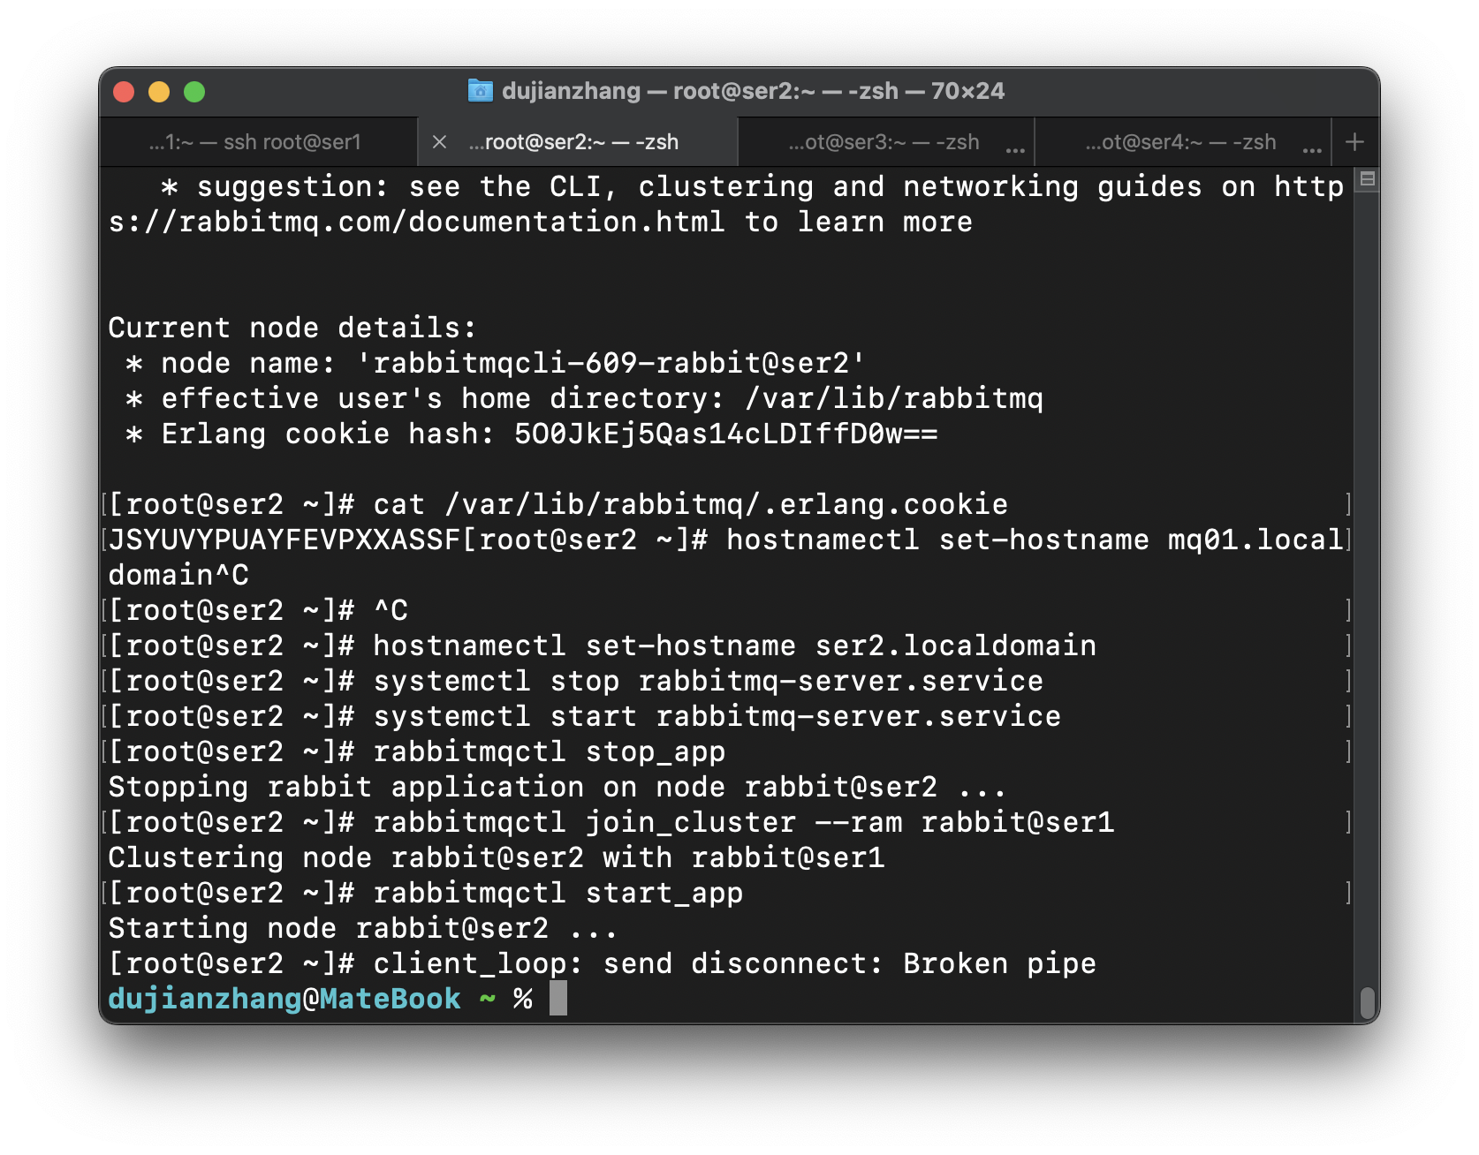
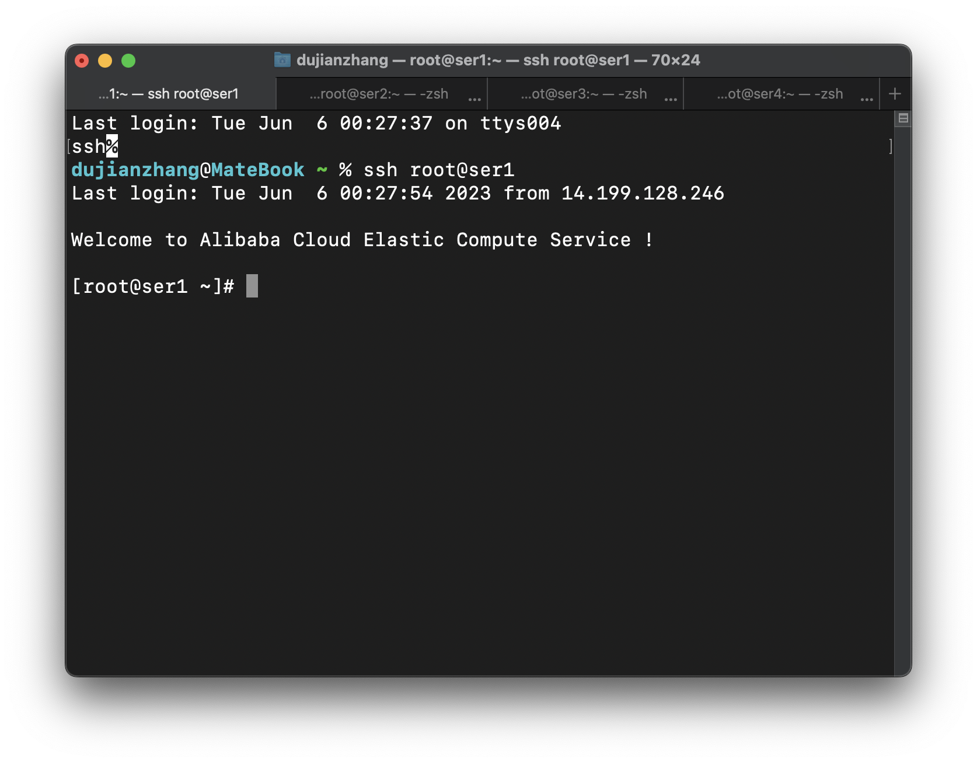
Backend
Servers
Linux CentOS 7.9
Rent on Aliyun
4 EC2 Servers

Slide 7
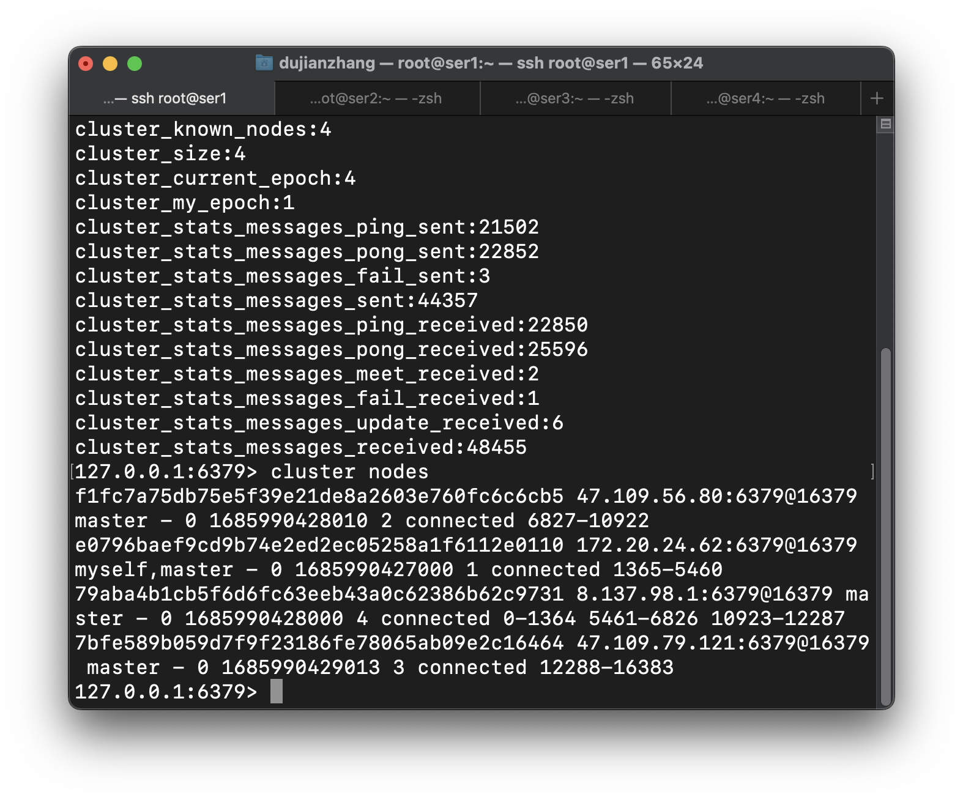
Backend
Redis Clusters
4 Masters
Segmentation of Slots

Slide 8
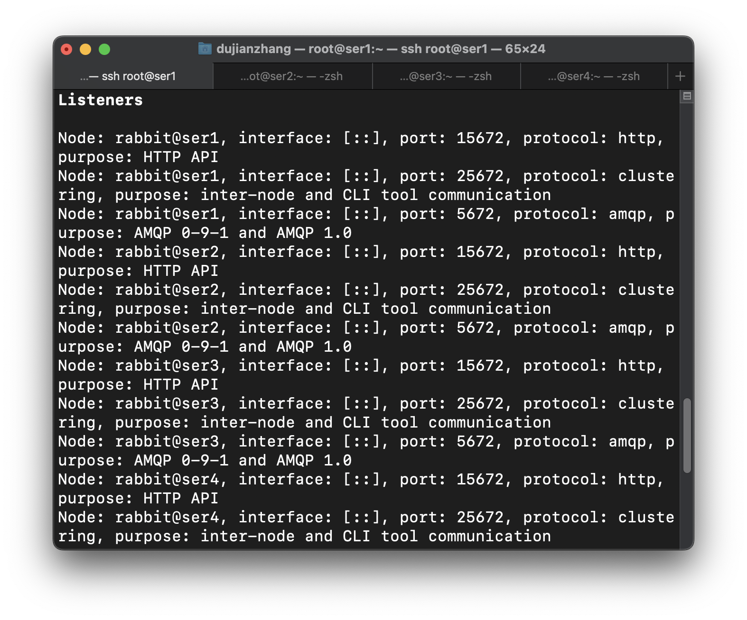
Backend
RabbitMQ
Clusters
4 Instances
Share the pressure

Slide 9
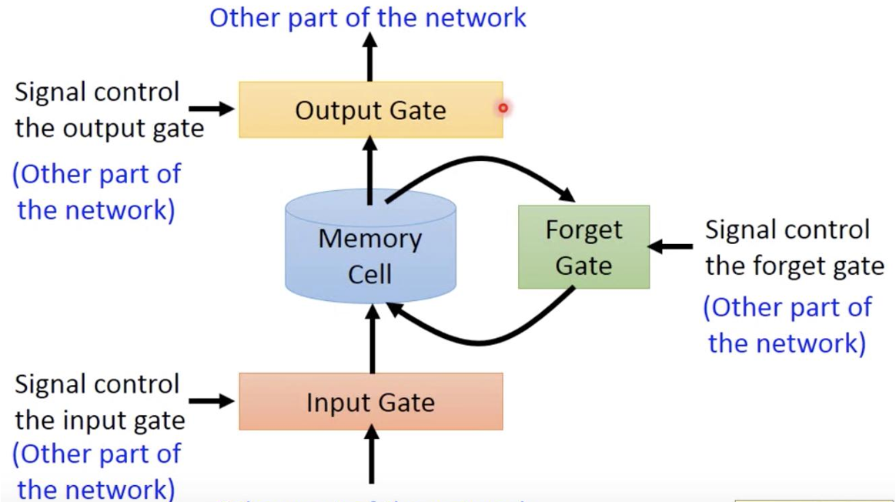
Research
LSTM

Slide 10
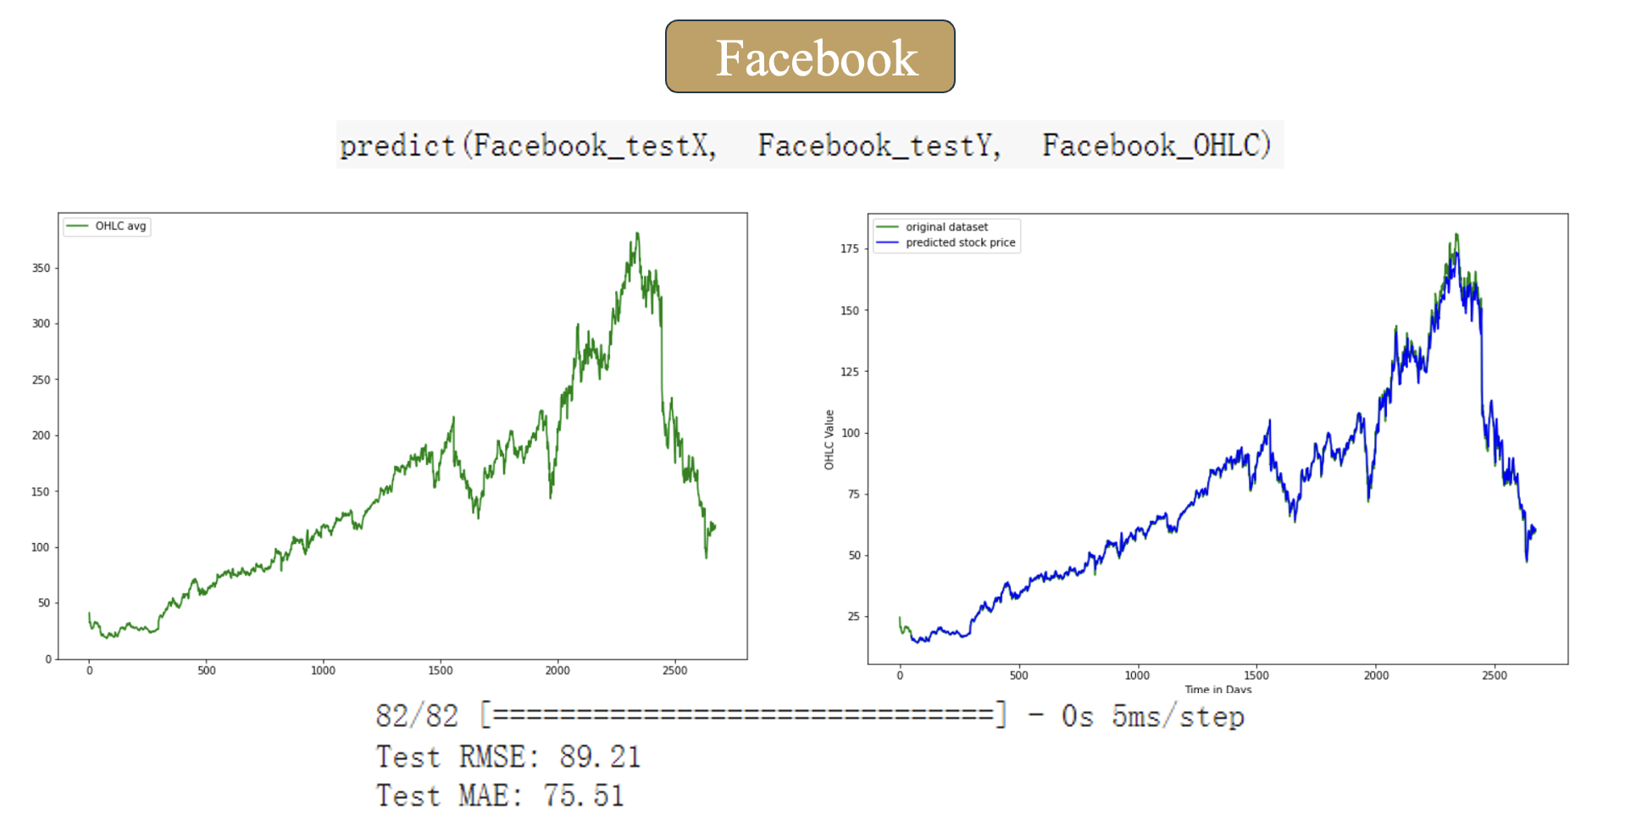
Research
Result

Slide 11
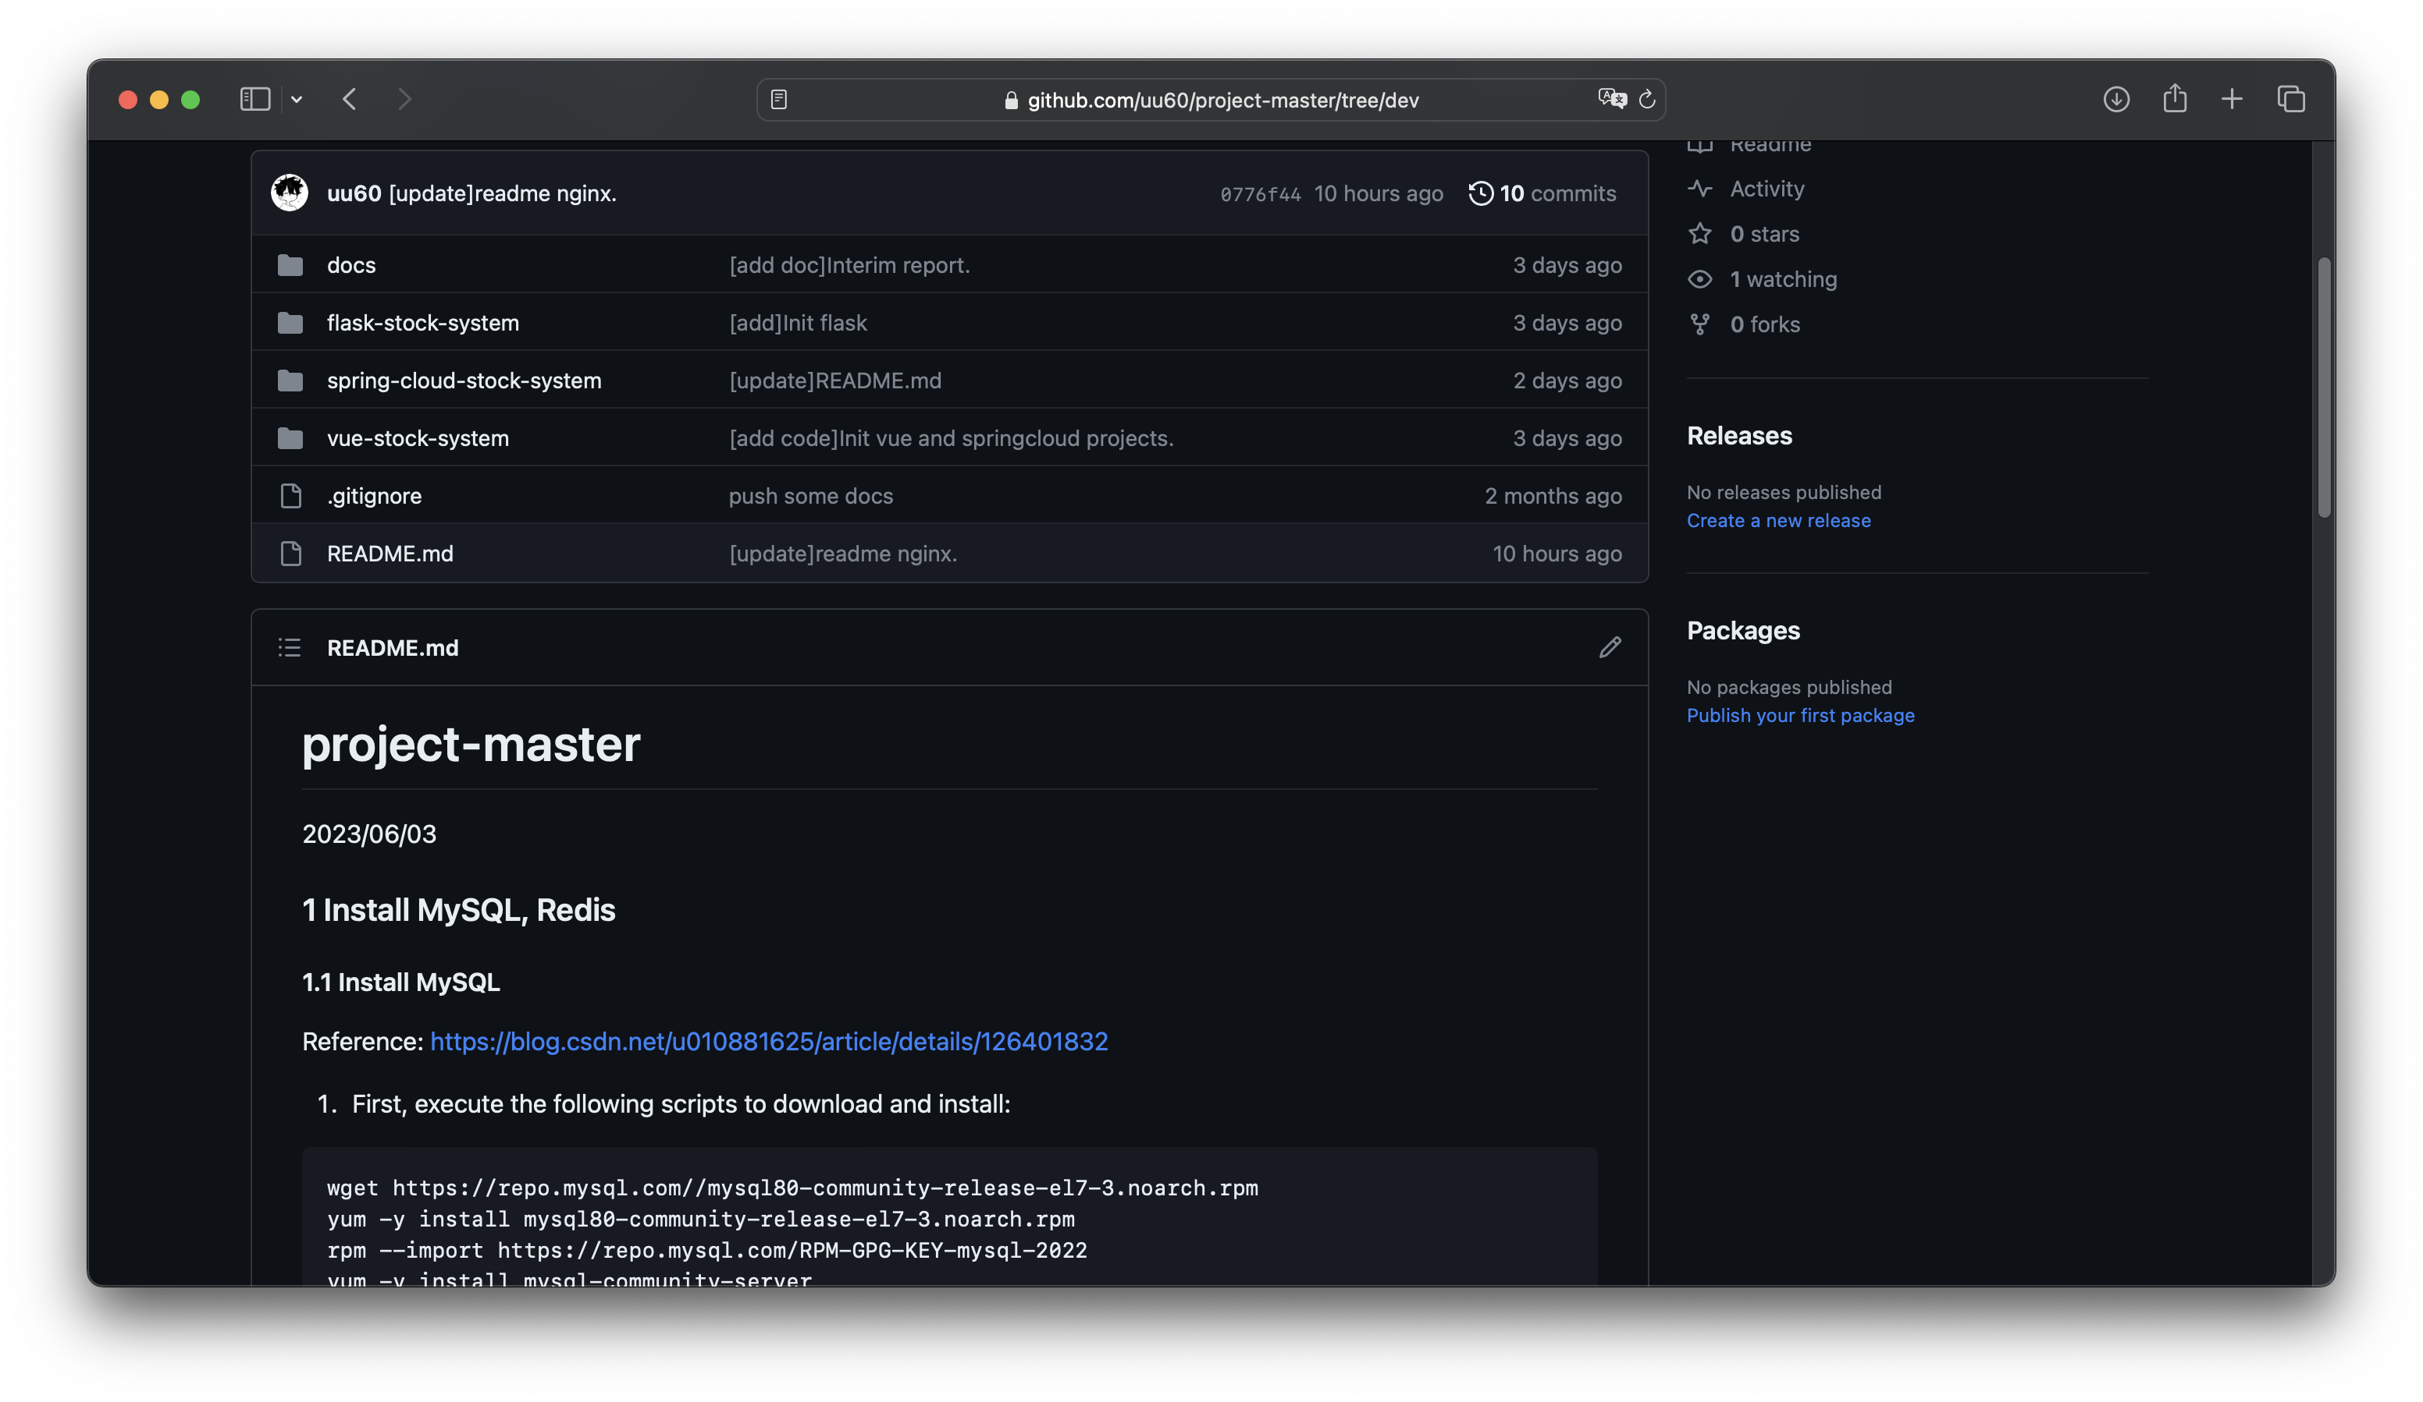
Github
https://github.com/uu60/projectmaster/tree/dev

Slide 12
Thank you
Group members:
Du Jianzhang, Wu Zhouyin, Yang Anjinyu, Xie Tianyou
Notes:
(DOSB) acceptance of chess
(a) a sport has to
include some form of physical activity; (b) it should convey ethical values, such as fair play, equal opportunities, as well as a
person’s inviolability; and (c) clear organisational structures need to be existent

